Slide 1


17
Quant Co.’s Renewable Future:
Growth Strategy & Insurance Solutions
Presented by:
Fida Mohammed Shebeaun, Nasywa Talitha
Yanfei Huang, Hantian Chen

Slide 2

Table of Contents
Our Mission
3
Quant Co. and Stronghold: Leveraging
Parametric Insurance 18
Background
4
Parametric Insurance of Global Market 19
Parametric Insurance by the Numbers 20
Advantages of Stronghold PI for RE Ventures 21
Quant. Co Oil & Gas Existing Portfolio 5
Strengths 6
Financial Strengths 7
Risk 8
Financial Risk 9
Renewable Energy Transition 10
Overall Recommendations 24
Short Term Recommendations 25
Long Term Recommendations 27
Renewable Viability and CAT Risk
Analysis 11
Opportunities and Challenges 12
CAT Events Analysis 13
Conclusion 17
References 29
Contact Us 32

Slide 3
Our Mission
illuminate pathways to a sustainable energy future, empowering clients like Quant Co. to boldly transform and thrive in a rapidly evolving world.

Slide 4
Background
You can’t solely rely on what’s beneath your feet when opportunity shines above.
Shifting energy landscapes demand strategic evolution.
Objective: Outline Quant Co.'s strategic entry into the Canadian solar and wind energy markets, capitalizing on existing capabilities and supporting national sustainability goals.
Utilize Stronghold’s parametric insurance to protect renewable energy revenue from weather-related losses.
Key Risks: grid integration, regulatory hurdles regarding land use & public perception.

Slide 5
Quant Co.’s Oil & Gas Existing Portfolio
Strengths & Risks Assessment

Slide 6
Strengths
Abundant resources & well-established business line.
Produces 80% of Canada’s oil.
Profitable market.
Total assets (2022) =$489.9b
Gross Revenue = $174b
In-house vertical control.
Reduce third-party interference.
Transferrable skills to renewable sector like offshore & engineering skills
Upstream
Midstream
Downstream
Market
Integrated
Convenient transport: comprehensive pipeline network for gas.
Leveraged for transporting hydrogen. (offers strategic flexibility)
Securing permits & negotiations are easier.
Strategic hedge.
Fossil fuels may still dominate non-OECD markets
6
Notes:
Market: market dominance and knowledge
Add page number

Slide 7
Financial Strengths
Overall growth in total revenue: increased over 67% from 2020 to 2022.
Gross profit confirms strong market performance in upstream operations.
Revenue
Assets
$18B to $7.7B from 2023 to 2020, rapid growth of business expansion.
Debt to Asset Ratio
Stable below 0.6, decreasing trend.
Not overleveraged, room to take on additional debt.
ROA
At 5% , which is above industry average of 3.9%.
Maximizing usage of assets for profits.
7
Notes:
The overall growth in total revenue(increasing over by 67% in just two years,from 2020 to 2022) and gross profit confirms a strong market performance, particularly in upstream operations. (reflect a solid customer base and market demand)
The total assets doubled from 2020($7.7B) to 2023(nearly $18B), signaling the rapid growth of business expansion.
The Debt-to-Asset ratio is stable below 0.6 with a decreasing trend, indicating the company maintains financial discipline and is not overleveraged. (same comment for me)(gives room to take on additional debt if needed for renewable energy investment)
ROA of roughly 8.7% higher than the required 5% and means the company is using its assets to generate profits ; also above industry average (3.9%) with reference to the site.

Slide 8




Risks
Sustainability
Neither oil nor gas is a sustainable resource
Oversupply
The mature business line has intensified competition among producers, leading to sustained low prices and less profit.
Regulation​
Governments' new release highlights the cut off on oil and gas with suggestions of launching new green energy​
ESG Lag
“While Canada has been a leader in the oil and gas sector, it has been lagging behind the US and EU in ESG initiatives” indicating potential of future trade
8

Slide 9

Financial Risks
Gross Profit
Drops 26% from 2021 to 2023 despite the increasing total revenue.
Operation expense
Doubled from 2020 to 2023, reached 19% of total revenue in 2023
Keep growing in 2023 while the total revenue falls
Operating Margin
Peaked in 2021, decreased in 2023 to 7.61%, poor profitability and cost efficiency in 2023
Total Asset​
Drops 26% from 2021 to 2023 with profitability falls, expanding too aggressively without ensuring profitable growth
9

Slide 10






Imperatives for Transition
Policy
Canada has brought up new strategies in 2023 to update regulations to cut down oil and gas emissions and financially encourage the production and consumption of renewable resources.
Stability
Stable decreasing Debt-to-Asset ratio provides a solid financial foundation for transitioning to more sustainable operations.
Urgency
Fixed costs will gradually grow higher year by year due to the maintenance of aging machinery, continuously rising labor costs, etc.
10

Slide 11
Renewable Viability and CAT Risk Analysis
Opportunities & Challenges, CAT Events: Hail, , Fire, Flood, Windstorm
11

Slide 12


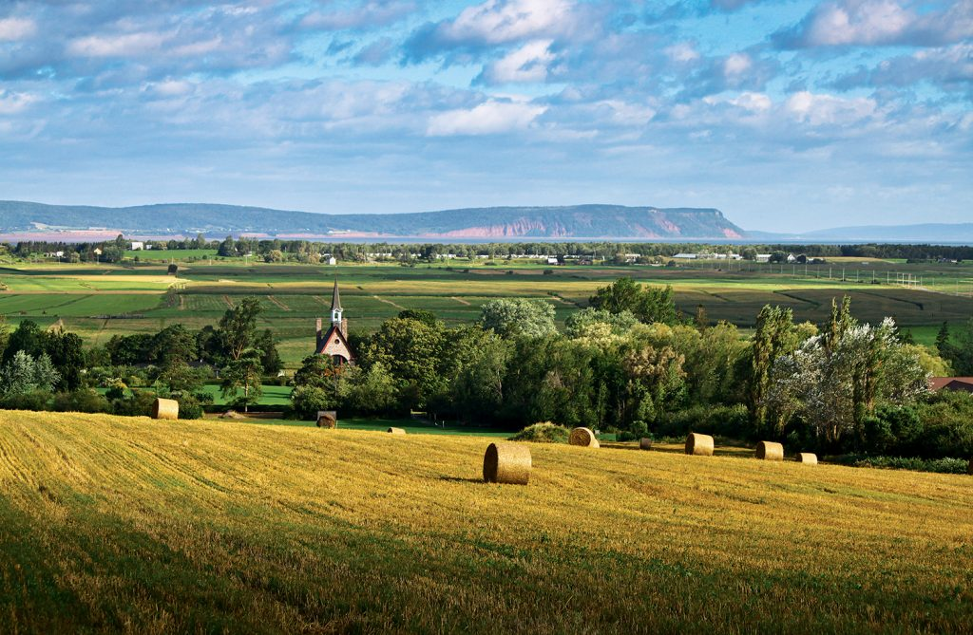
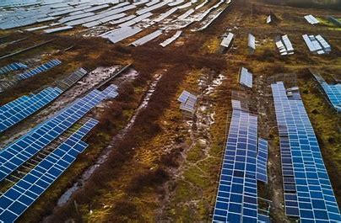
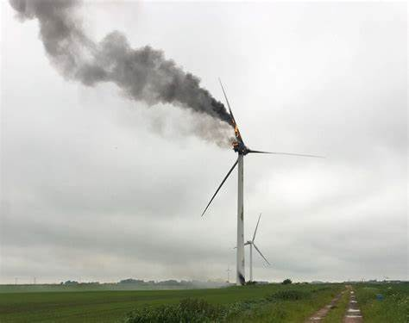
Renewable Energy Opportunities and Challenges
Opportunities
Challenges
Quant. Co' Reputable Position
Strong reputation and credibility in the energy sector
Established supply chain and infrastructure that can support renewable
Favorable Strategic Positioning
Government regulation
ESG pressure
Investor demand
Business diversification
Geographic Advantage (Rural Areas)
More abundant land available
Lower insurance premium
Higher exposure to wind and solar.
Operational & Infrastructure Limitations
Rural Location: slower repairs, limited emergency responses
Policy restrictions: e.x. Ontario's solar ban on agricultural land
Insurance and Financial Uncertainty
Harder to insure renewable farms
Exposure to high CAT events risks
Parametric insurance still evolving
Data Limitation
we assume that the data (total exposure and total loss) of CAT events that grouped together are weighted equally
12

Slide 13
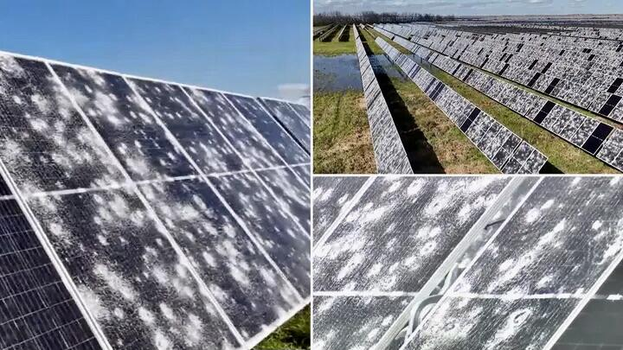
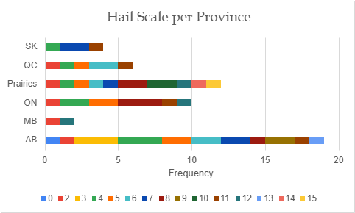
CAT Event Analysis: Hail
Hail events pose a significant risk to solar farms, both in frequency and financial severity. On average, hail-related losses amount to $20.5 million per incident. Damage can compromise the integrity of solar cells, loosen internal wiring, and lead to long-term performance degradation, making hail one of the costliest and technically disruptive hazards for solar infrastructure.
Loss Data
Hail Scale Data
Conclusion:
Alberta: Highest frequency of hail events with consistent moderate-to-severe scales
Ontario & Prairies: Moderate frequency; Prairies recorded the most extreme event (scale 15)
Manitoba, Saskatchewan & Quebec: Low frequency and mostly low-to-moderate scale events
Risk is consistent: Provinces with high average losses also show high max losses, indicating stable regional hail patterns
13

Slide 14
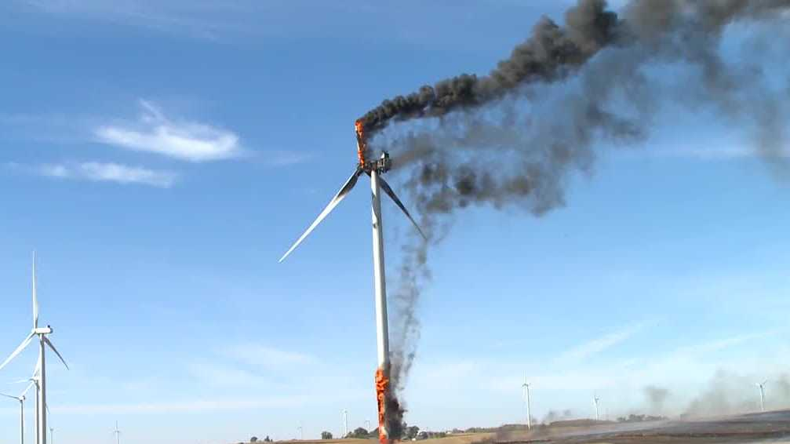
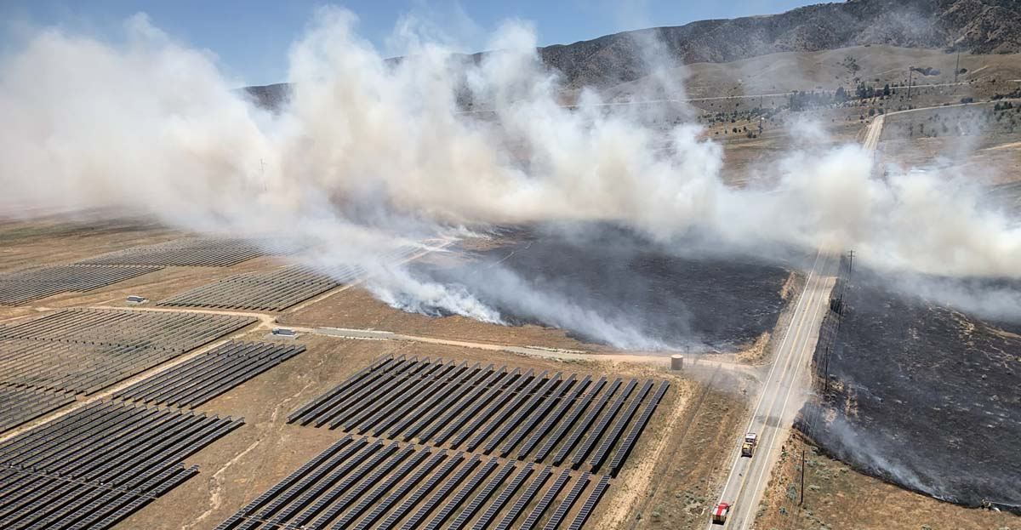
CAT Event Analysis: Fire
Fire events pose a serious threat to both solar and wind farms, primarily due to high temperatures, battery storage vulnerability, and high-voltage electrical components. Damage from wildfires can result in costly replacements of solar panels, inverters, or wind turbines, making fire a major financial and operational risk for renewable infrastructure.
Frequency of Fire Event
Average Total Loss (billions)
Average Burned (ha)
Average Destroyed (ha)
Risk Level
Province
Alberta
2
1.731505
280,732
1,692
High Risk
British Columbia
5
0.442478
65,388
1,013
Moderate Risk
takeaways:
Avoid Alberta for both Solar and Wind Farms.
Mitigation needed in moderate risk area like British Columbia and Prairies
Maritimes
2
0.13576
15,027
731
Low Risk
Prairies
2
0.066205
46,596
1,788
Moderate Risk
Conclusion:
Alberta: High risk — large burn areas, high losses, and high structural damage
British Columbia: Moderate risk — frequent fires with manageable losses; requires mitigation (e.g., firebreaks)
Maritimes & Prairies: Lower risk — less severe and less frequent fire events; more viable for expansion
14

Slide 15
CAT Event Analysis: Flood
Mainly affects solar farms near ground level
Influenced by:
Geography: proximity to rivers, floodplains, coastal zones
️Topography: low elevation or flat terrain increases risk
Rainfall: high-intensity storms (measured in mm) signal flood potential
Rainfall Data
takeaways:
BC has the highest average and extreme rainfall
AB, QC, Maritimes show high max rainfall ON &
Prairies have moderate averages but unpredictable spikes
SK, MB, NS have lower rainfall overall
Conclusion
Province | Rainfall Risk | Loss Impact | Overall Flood Risk
BC | Very High | Very High | High
ON | Moderate | Very High | High
QC | High | High | High
Maritimes | High | Low - Mod | Moderate
Prairies | High | Low | Low-Mod
SK/MB/NS | Low | Low | Low
Loss Data
takeaways:
Avoid BC,QC, and ON for solar without strong flood mitigation
Maritimes are moderate-risk — viable with elevated design
Prairies are borderline; low losses but high rainfall → monitor closely
SK, MB, NS offer lower-risk options for ground-mounted solar
takeaways:
Financial loss due to flood events affect BC, ON, and QC the most
15

Slide 16
CAT Event Analysis: Windstorm
Winter storms primarily impact wind farms, with extreme wind gusts and ice buildup leading to turbine shutdowns, equipment damage, and significant production losses. Severe events can halt operations for hours or days, making windstorm risk a key consideration for site selection and insurance planning.
Loss Data
Wind Speed Data
Average of Max Wind per Province
Province | Average of Max Wind (km/h) | Category (based on SSHWS as reference)
AB | 128.33 | 3 (Devastating)
BC | 121.43 | 3 (Devastating)
Maritimes | 106 | 2 (Extensive)
ON | 107.88 | 2 (Extensive)
Prairies | 106 | 2 (Extensive)
QC | 110.33 | 2 (Extensive)
Maximum of Max Wind per Province
Province | Maximum of Max Wind (km/h) | Category (based on SSHWS as reference)
AB | 147 | 4 (Catastrophic)
BC | 147 | 4 (Catastrophic)
Maritimes | 148 | 4 (Catastrophic)
ON | 148 | 4 (Catastrophic)
Prairies | 109 | 2 (Extensive)
QC | 148 | 4 (Catastrophic)
BC and AB appear to have the highest loss among other provinces.
AB and BC have the highest average max wind speeds
All provinces except the Prairies recorded anomalous peak wind speeds (≥147 km/h)
Conclusion:
Avoid Alberta and BC for wind farm expansion due to highest losses and highest average max wind speeds
Other provinces are not risk-free — all except the Prairies have experienced catastrophic wind gusts
Mitigation is essential — recommend parametric insurance with wind speed triggers to manage extreme event risk
16

Slide 17
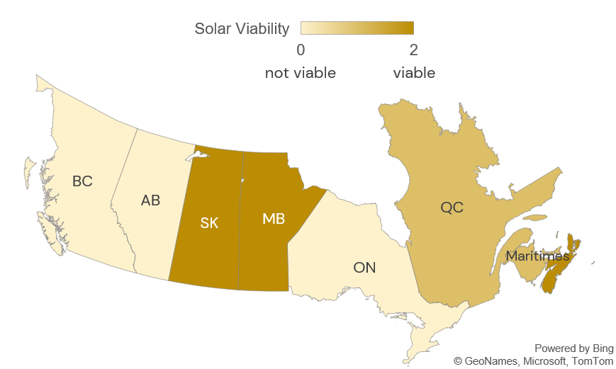
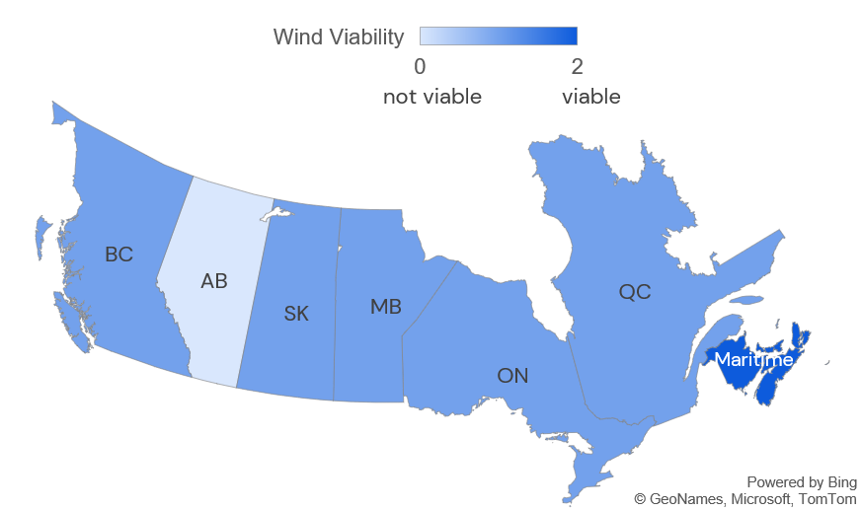
Conclusion: Solar and Wind Farm Viability
Solar Farm Viability
Wind Farm Viability
17

Slide 18
Quant Co. and Stronghold: Leveraging Parametric Insurance
for Optimal Protection & a CAT Risk Solution
18

Slide 19
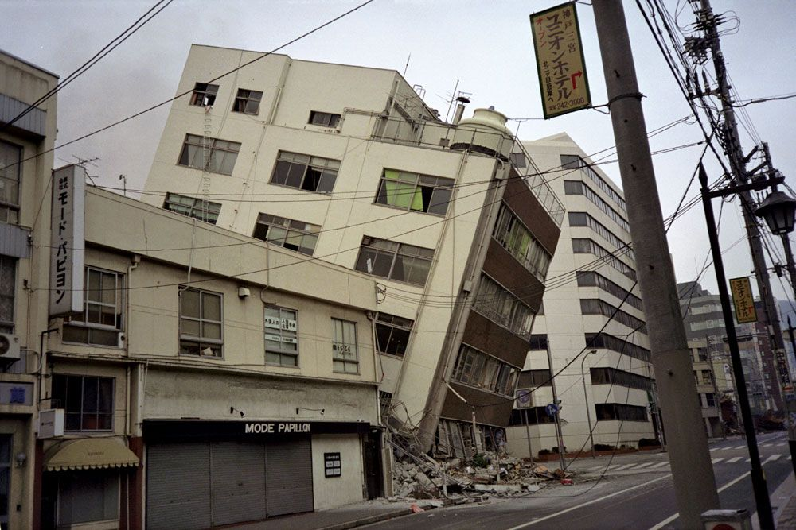
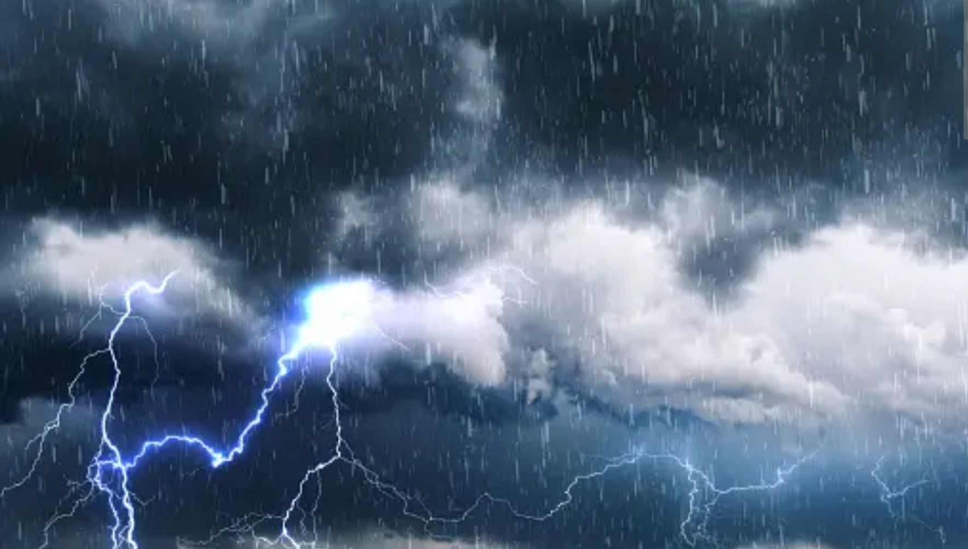
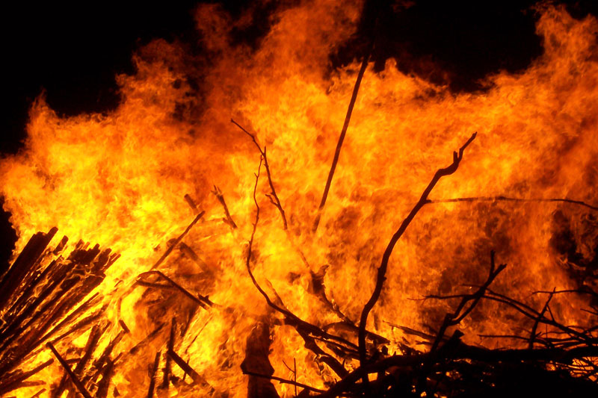
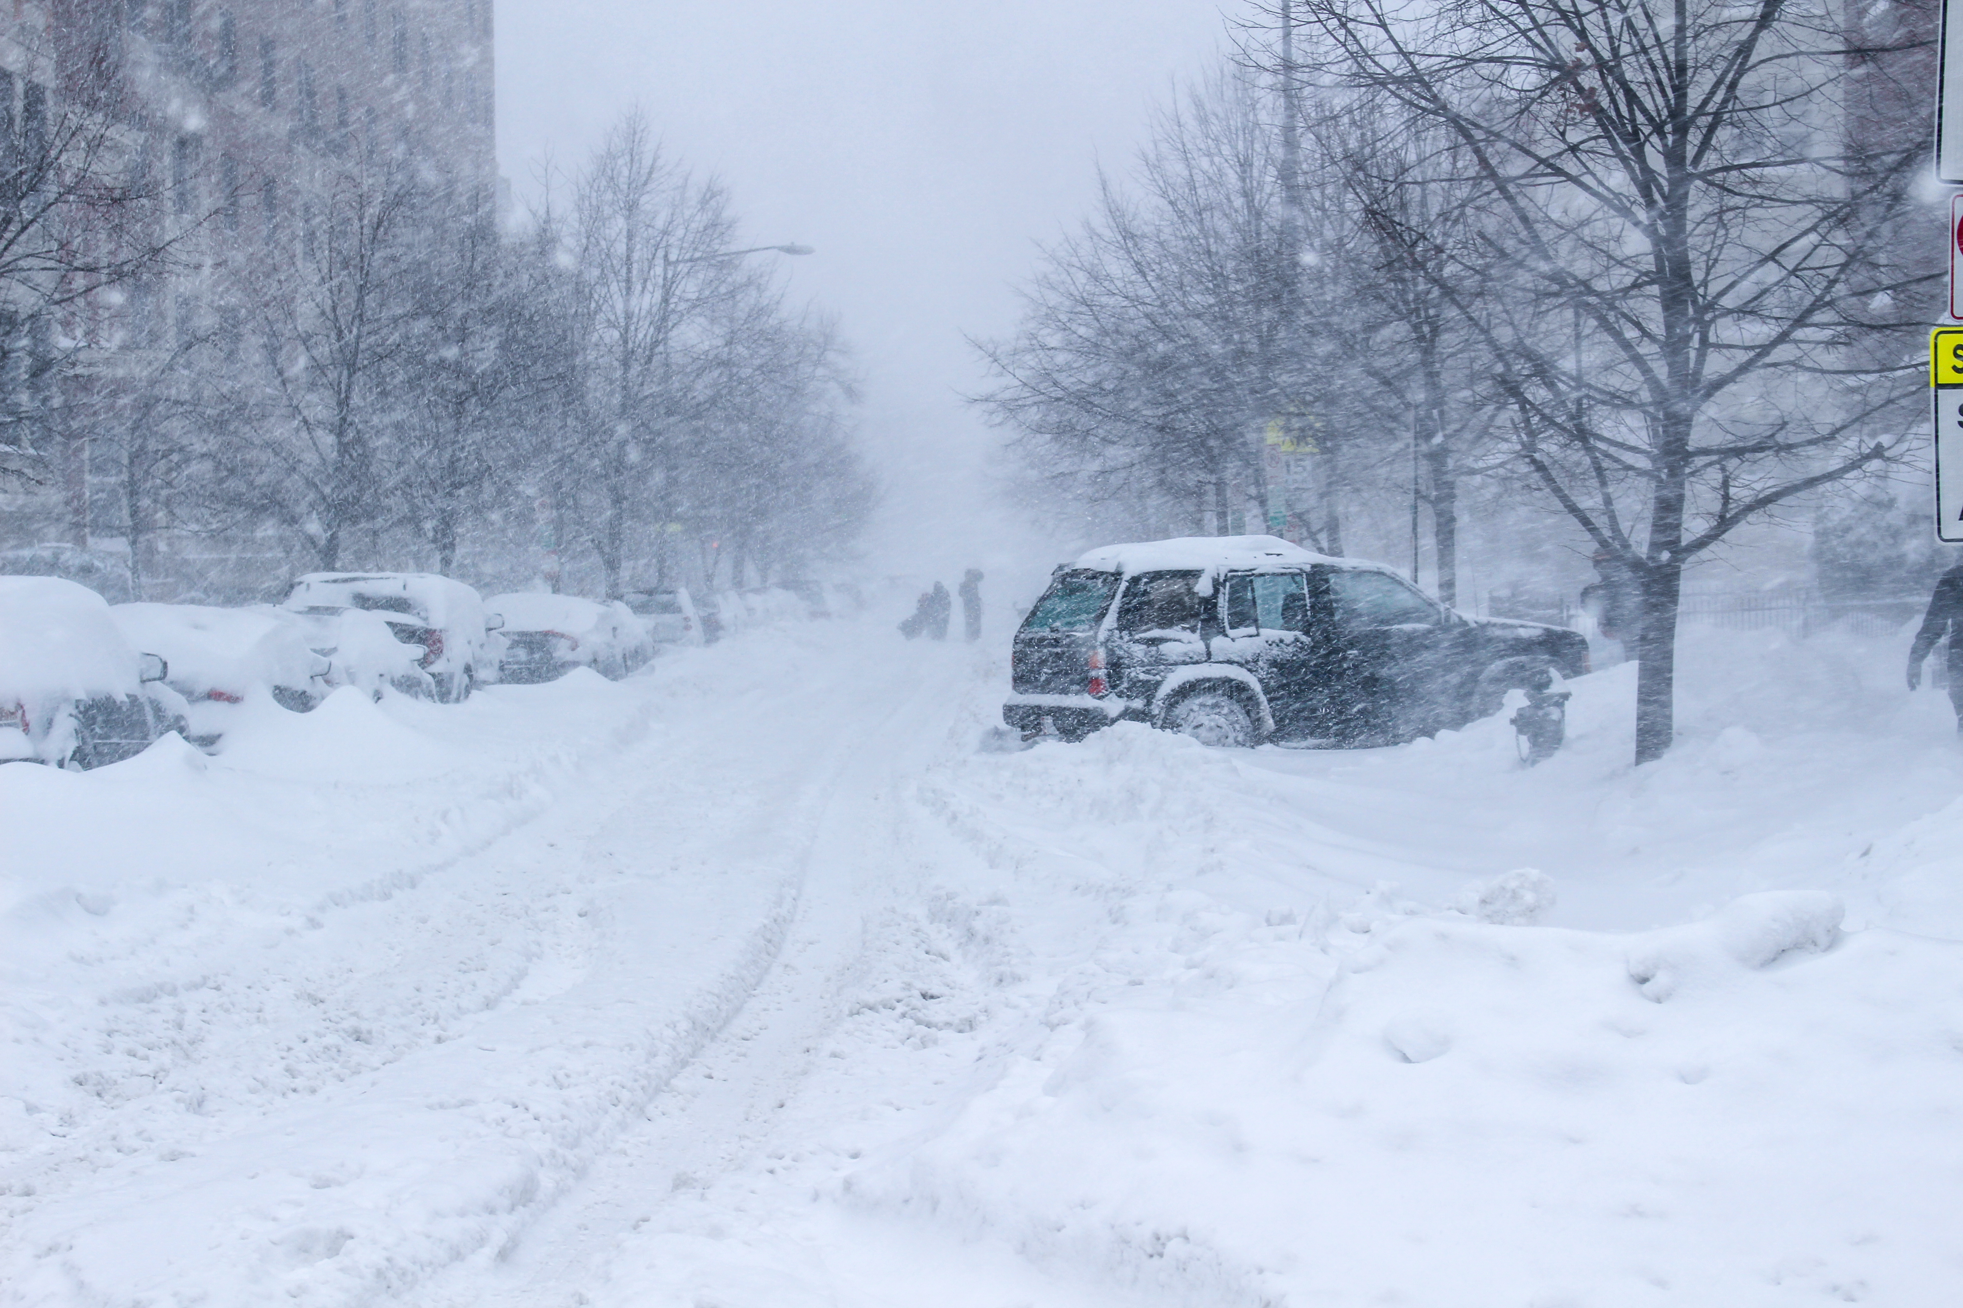
Parametric Insurance Global Market Overview
Insurance that pays out based on the occurrence of a pre-defined event (a parameter), not on the actual losses incurred.
Key Advantage: Fast payout, increased transparency, reduced disputes.
Parametric insurance market is experiencing significant growth globally, driven by increased climate volatility and the need for rapid payouts after disasters.
Earthquake
Rainstorm
USD
51.3B
8.4B
2034
USD
16.2B
CAGR: 12.6%
2024
2024
2034
Fire
Winter storm
Rising at compound annual growth rate 12.6%.
10-year US parametric insurance market size growth projection
Triggers
19

Slide 20



Parametric Insurance By the Numbers
Facts & Overview
Financial Aspects
Capital Efficiency: more capital efficient for insures compared to traditional indemnity insurance.
Investment: Growing interest from institutional investors in parametric insurance products as an alternative asset class.
Statistics & Data
CAT Bond Market & related ILS witnessed USD7.1B in 2025Q1 , increasing outstanding market size to USD52.2B
North America
Caribbean
Increasing use for weather-related events.
High adoption for hurricane protection.
Frequency & Severity: WMO estimated that extreme weather and climate events have resulted in 12,000 reported disasters between 1970 and 2021 causing over 2 million deaths and USD4.3 trillion in economic losses.
Asia-Pacific
Regional Hotspots
Growing market for agriculture and flood risk.
Popular high growth area for
Parametric Insurance
20

Slide 21
Advantages of Stronghold’s Parametric Insurance for Renewable Energy Ventures like Quant Co.
Faster Claim Settlements
Customizable Payout Triggers
Traditional insurance needs loss adjusters. But through Parametric Insurance Quant Co. receives funds quickly to cover revenue losses from downtime in their renewable energy operations.
Daily average wind speeds below a threshold, or extreme wind speeds above limits.
Solar irradiance below a defined level.
Reputation
Coverage Structure
Hold of 12% market share across Canadian provinces.
Smoother negotiations, favorable terms for contract.
Stronghold's research into specific parameters like wind speed (Saffir-Simpson) and hail size (CatIQ Hail Scale) demonstrates their proactive approach.
Pre-agreed payout amounts for each trigger events.
Potential for dual or multi-peril policies for various weather risks.
21

Slide 22
Conventional Insurance vs. Stronghold’s Parametric Insurance from a reserve management point of view
Conventional insurance requires higher reserves due to claim uncertainties.
Payouts are immediate in parametric insurance, significantly reducing reserve volatility. Capital can be deployed more efficiently rather than being locked in claims reserves.
Customized Payout Structure of Stronghold
Payout for Wind Farms:
Trigger 1: Sustained Wind Speed ≥ 119 km/h (Category 1 Hurricane Equivalent): Payout Mechanism: Incremental Payout - A predefined initial payout amount is triggered upon reaching this threshold, acknowledging potential mechanical stress and minor damage even with turbine shutdown.
Trigger 2: Sustained Wind Speed ≥ 130 km/h (Category 2 Hurricane Equivalent): Payout Mechanism: Incremental Payout - An additional predefined payout amount is added to the Trigger 1 payout, reflecting increased risk of blade damage and structural issues.
Trigger 3: Sustained Wind Speed ≥ 154 km/h (Category 3 Major Hurricane Equivalent): Payout Mechanism: Layered Payout - A significant additional layer of coverage with a predefined payout amount is triggered, recognizing the high probability of substantial damage and prolonged downtime.
Customized Payout Structure of Stronghold
Payout for Solar Farms:
Trigger 1: Maximum Hail Diameter ≥ 6.5 cm (CHS likely severe damage threshold): Payout Mechanism: Proportional Payout - The payout amount is proportional to the maximum recorded hail diameter exceeding 6.5 cm, up to a predefined limit.
Trigger 2: Maximum Hail Diameter ≥ 9.0 cm (CHS significant damage potential): Payout Mechanism: Incremental Payout - An additional predefined payout amount is added to the proportional payout from Trigger 1, recognizing the increased severity and potential for widespread damage.
Trigger 3: Maximum Hail Diameter ≥ 11.5 cm (CHS maximum classification): Payout Mechanism: Layered Payout - A final layer of coverage with a predefined payout amount is triggered, representing the highest level of hail impact and likely requiring significant repairs or replacements.

Slide 23
Advantages of Parametric Insurance based on past CAT Events
Stronghold’s Parametric Insurance Advantages based on Potential Losses from Historical Data (example Hail)
For expected high-end losses from severe hail events (potentially in the range of $0.08 - $0.12 billion based on recent data), Stronghold's parametric insurance, linked to the objective and damage-correlated CatIQ Hail Scale, offers - rapid, transparent, and efficient mechanism to provide substantial financial support, mitigate the protection gap, and ensure quicker recovery for Quant Co.'s solar energy investments.
Stronghold’s Parametric Insurance Advantages based on Potential Losses from Historical Data (example Fire)
The Fire_11 event in 2024 resulted in a very substantial loss of $1.44105 billion with a massive area burned (173,928 hectares). This highlights the potential for extreme financial damage from wildfires.
A hybrid approach incorporating parametric triggers based on fire proximity or regional burn area for rapid initial payouts and operational disruption coverage, combined with traditional indemnity for physical damage, could provide a comprehensive and effective risk transfer solution for Quant Co.'s renewable energy assets in fire-prone regions.
23

Slide 24
Overall Recommendations & Risk Mitigation
Short Term & Long Term
24

Slide 25
Short-Term Recommendations
Expansion into the Canadian solar and wind energy market presents a viable and strategically aligned opportunity for Quant Co., offering synergies with existing project development and management expertise and aligning with national clean energy goals.
Recommendation
1
Launch phased solar (10MW) & wind pilot expansions in low-moderate CAT Risk Regions.
Supportive Polices in MB & SK such as MB’s Clean Energy Strategy, govt. supported investments, Indigenous loan guarantee program (help obtain funds for Quant Co.)
MB & Maritimes heavily rely on RE (97% electricity generated from solar & wind) implying a profitable market. Enter market through potential partnerships or set up in-house projects. Operating costs are minimal, and capital costs are predicted to decrease over time until 2040.
Start with a pilot project (5–10 MW): Estimated capital requirement = CAD4.5M–CAD10.5M
As shown in Canada’s Energy Future 2018 projections, solar capital costs are declining to CAD650–1100/kW by 2040. Quant Co. , as a legacy oil & gas company, likely has substantial revenue reserves & borrowing capacity.
Risk Mitigation
Apply fire-safe zoning and spacing around wind farms (NS, NB, PEI)
Set up emergency response protocols and local maintenance partnerships
25

Slide 26
Short-Term Recommendations
Recommendation
2
Parametric Insurance with Stronghold.
Implement parametric insurance with Stronghold. Using hail size triggers (CHS >= 6.5cm) and wind speed triggers (SSHWS >=119 km/h) in AB and BC to cover high-risk zones.
Establish CAT reserve fund, a self-funded reserve account that Quant. Co sets aside specifically to respond to high-impact weather events. This works by allocating a small percentage of project budget in high-risk regions (e.g., AB and BC) into a separate CAT reserve. It can be used for immediate repairs not fully covered by insurance and delays in insurance payout (in traditional policies)
Risk Mitigation
Combine with Traditional Insurance for coverage gaps like fire damage.
Recalibrate thresholds annually using updated CAT event data and scale such as CHS & SSHWS.
Establish early warning systems tied to parametric trigger thresholds.
Recommendation
3
Leverage internal assets and external funding.
Diversify Financing Sources by combining internal reserves (retained earnings or asset recollection) and external funding options (government grants or strategic partnerships) to avoid over-reliance on any single capital stream and limit the exposure to market volatility.
Limit Debt Exposure and Preserve Financial Flexibility by maintaining moderate debt levels below 0.75—a threshold generally considered high based on historical data from U.S. oil and gas companies.
26

Slide 27
Long-Term Recommendations
A strategic pivot towards renewable energy, coupled with robust risk management, positions Quant Co. for sustained growth and resilience in the evolving global energy landscape.
Recommendations
Qualitative Benefit
Quantitative Benefit
Recommendation
1
Expand into high-risk regions in AB, ON and BC, using a blend of parametric and traditional insurance coverage. (Monitor the update CAT risk data to reassess and recalibrate parametric insurance thresholds annually)
Enhanced investor confidence and stronger stakeholder trust arise from demonstrating a proactive approach to managing significant risks in high-potential renewable energy markets. Signals a commitment to protecting investments and ensuring long-term stability.
The strategic layering of rapid parametric payouts with traditional insurance significantly reduces the potential for substantial uninsured financial losses following severe CAT events. This blended approach also accelerates recovery by providing immediate funds while traditional claims are being processed.
Risk Mitigation
Conduct site-specific risk assessments before expansion
Use elevated solar panel structures in flood-prone zones (Maritimes)
Use wind turbines with auto shut off systems if it exceeding the wind speed triggers in moderate-to-high wind areas (ON, QC, BC)
Apply seasonal trigger adjustments to parametric policies
27

Slide 28
Long-Term Recommendations
Long-term outlook for the oil and gas sector is characterized by increasing pressure for decarbonization and a potential decline in demand as the global energy transition progresses. Expansion in solar and wind sectors
Recommendations
Qualitative Benefit
Quantitative Benefit
Recommendation
2
Strengthen Quant Co. position as a national renewable leader with ESG credibility. (By using clean energy expansion to strengthen ESG ratings, Quant Co. can regain investor confidence and unlock the green capital market)
Improved ESG ratings can attract investors and enhance public reputation.
Aligns with Canada’s climate regulations and stakeholder expectation.
Access to lower-cost capital. Green bonds and sustainability-linked loans typically offer 0.25%–0.50% lower interest rates compared to conventional bonds.
Recommendation
3
Develop internal risk analytics and resilience modeling. (This unit can integrate CAT exposure mapping and weather modeling, which can help reduce long-term insurance costs and make smarter expansion decisions)
Enables site-specific CAT risk forecasting for smarter project sitting and design
Reduce reliance on third-party consultants
Building in-house analytics capabilities can save $500,000-$1million annually in external consulting fees.
Optimized site selection and reduced downtime can increase IRR(internal rate of return)on future renewable projects by 1% - 2%.
28

Slide 29
References
29

Slide 30
References
Boisvert, E. (2024, February 12). What is the risk of wind turbine fires? And how dangerous can they be? ABC News. https://www.abc.net.au/news/2024-02-12/wind-turbine-fire-concerns-risks-danger/103443918
Bush, O. (2023, May 6). Oil and Gas Industry Statistics in Canada for 2023 - Made in CA. Made in CA. https://madeinca.ca/oil-and-gas-industry-statistics-canada/
Finimize Newsroom. (2024, October 11). Canadian Natural Gas Faces Pricing Squeeze With Oversupply Issues. Finimize. https://finimize.com/content/canadian-natural-gas-faces-pricing-squeeze-with-oversupply-issues?utm_source=chatgpt.com
FullRatio. (2024). Return on Assets (ROA) by industry - FullRatio. Fullratio.com. https://fullratio.com/roa-by-industry
Government of Canada, National Energy Board. (2022, July 28). CER – Provincial and Territorial Energy Profiles - Canada. Canada Energy Regulator. https://www.cer-rec.gc.ca/en/data-analysis/energy-markets/provincial-territorial-energy-profiles/provincial-territorial-energy-profiles-canada.html
Oak Business Consultant. (2023, June 1). Oil and Gas Industry: Overview, Financial Ratios and Future. Www.linkedin.com. https://www.linkedin.com/pulse/oil-gas-industry-overview-financial/
Olano, G. (2022, September 8). Fire a major hidden danger for solar farms. Insurancebusinessmag.com; Insurance Business. https://www.insurancebusinessmag.com/us/news/risk-management/fire-a-major-hidden-danger-for-solar-farms-419868.aspx
Ross, A., Vellone, J. A. D., & Matheusik, A. (2024, March 15). Canada’s path to net zero: The latest on clean electricity regulations and oil & gas emissions. BLG. https://www.blg.com/en/insights/2024/03/the-latest-on-clean-electricity-regulations-and-oil-and-gas-emissions
30

Slide 31
References
Team, H. C. (2025, February 26). Understanding Flood Risk Assessments for Solar Farms: An In-Depth Tutorial. Harbingerland Blog. https://blog.harbingerland.com/understanding-flood-risk-assessments-for-solar-farms-an-in-depth-tutorial/#key-factors-influencing-flood-risk-assessments-for-solar-farms
Climate Bonds Initiative. (2023, March). Green Bond Pricing in the Primary Market H2 2022. Climatebonds.net. https://www.climatebonds.net/files/reports/cbi_pricing_h2_2022_01c.pdf
Deloitte Insights. (2023). Predict and Prevent: Risk Management in the Age of Data. Deloitte. https://www2.deloitte.com/us/en/insights/industry/financial-services/financial-services-industry-predictions/2025/predict-and-prevent-risk-management.html
S&P Global. (2023). ESG Intelligence to Power the Markets of the Future. S&P Global. https://www.spglobal.com/en/capabilities/spglobal-esg-intelligence-to-power-the-markets-of-the-future.pdf
Ocampo, D., & Moreira, C. (2024). FSI Insights on policy implementation No 62 Uncertain waters: can parametric insurance help bridge NatCat protection gaps? https://www.iais.org/uploads/2024/12/FSI-IAIS-Insights-on-parametric-insurance.pdf
LinkedIn. (2025). Linkedin.com. https://www.linkedin.com/pulse/understanding-difference-between-parametric-insurance-hirbod-assa-ttpkf/
Comprehensive Guide to Parametric Insurance. (n.d.). https://corporatesolutions.swissre.com/dam/jcr:0cd24f12-ebfb-425a-ab42-0187c241bf4a/2023-01-corso-guide-of-parametric-insurance.pdf
Steinmann, C. B., Guillod, B. P., Fairless, C., & Bresch, D. N. (2023). A generalized framework for designing open-source natural hazard parametric insurance. Environment Systems & Decisions, 43(4), 555–568. https://doi.org/10.1007/s10669-023-09934-x
Renewable energy companies can use parametric insurance to recover from severe convective storms. (2025). Theinsurer.com. https://www.theinsurer.com/ti/viewpoint/renewable-energy-companies-can-use-parametric-insurance-to-recover-from-severe-2025-02-05/
‌
31

Slide 32
Thank You!
32

Slide 33
For any additional questions you can reach us at:
Fida Mohammed Shebeaun
fida.shebeaun@mail.utoronto.ca
Nasywa Talitha
n.talitha@mail.utoronto.ca
Yanfei Huang
yanfei.huang@mail.utoronto.ca
Hantian Chen
hantian.chen@mail.utoronto.ca
33

